Slide 1
HR Data capstone project
By
Akashatra Sharma and Raga sudha

Slide 2
Business Problem
To ensure there is no discrimination between employees, it is imperative for the Human Resources department of Delta Ltd. to maintain a salary range for each employee with similar profiles
Goal and Objective
The objective of this exercise is to build a model, using historical data that will determine an employee's salary to be offered

Slide 3
Data Description
We have collected handsome amount of data (25000 Applicants) from the HR team of Delta ltd. It contain 29 different parameter on which the salary judgement( Expected CTC) is processed. We have observed it contains both numerical & categorical data.
We do have Missing values in Department, Roles, Designation, education, education related columns.
Most of the missing values have arisen due to freshers & under graduates.

Slide 4


Slide 5
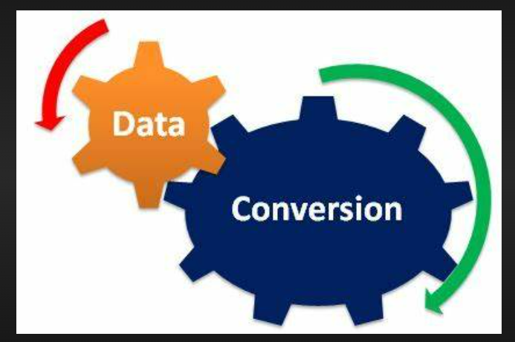
We converted the object data type into categorical data type before performing ANOVA test.
One way ANOVA Test was performed in order to determine which variables are significant and which are insignificant
As we performed the ANOVA Test, many insignificant variables were to be found out and thus we dropped them. Although the significant variables were kept and used them in the EDA & Model Building.
After conducting all this, we imputed null values in the significant variables with the relevant measures and proceeded further

Slide 6
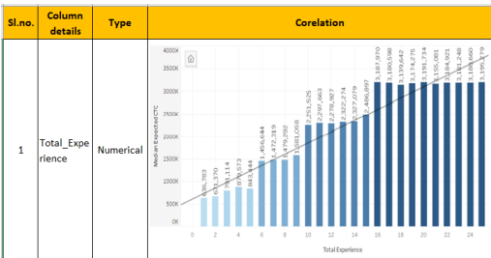
Exploratory Data Analysis
We have observed quite linear relationship with total experience.
Lowest exp median CTC is 636783
Highest exp median CTC is 3195279
80% increase in expected median CTC.

Slide 7
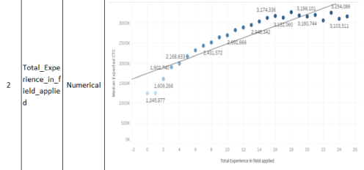
We have observed quite linear relationship with total experience in field applied
Lowest median CTC is 1245877
Highest median CTC is 3254086
61.71% increase in expected median CTC

Slide 8
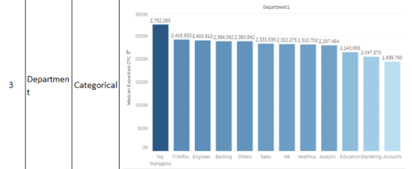
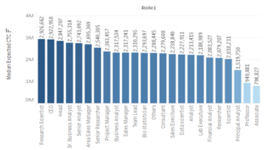
We have observed Top management has highest expected median CTC – 2752285
Accounts has lowest expected median CTC – 1939760
29% increase in expected median CTC
We have observed Research Scientist has highest exp median CTC – 2926662
Associate has lowest exp median CTC – 798827
72.7% increase in expected median CTC observed in role

Slide 9
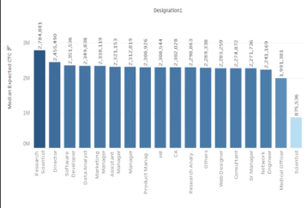
We have observed Research scientist has highest exp median CTC 2784881
Scientist has lowest exp median CTC 875536
Next to scientist medical officer has highest salary of 1991381
Further we can consider scientist as outlier and check model accuracy
68.5% increase in CTC is observed across designation considering scientist
28.5% increase in CTC is observed across designation considering scientist as outlier.

Slide 10
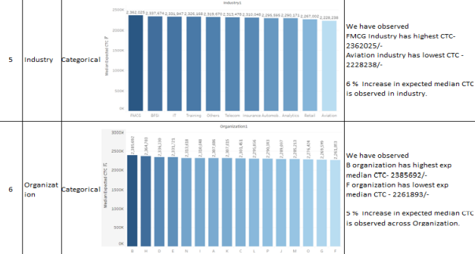

Slide 11
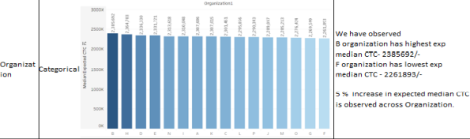
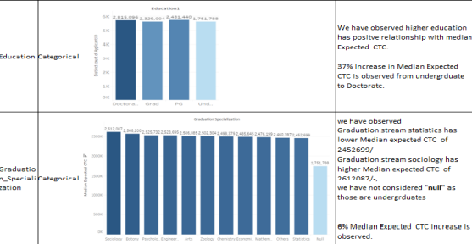

Slide 12
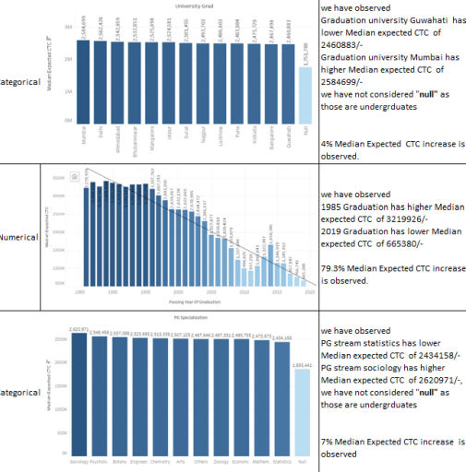

Slide 13
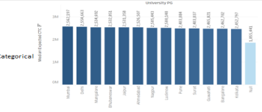
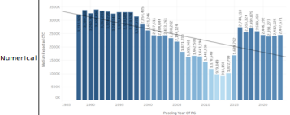
We have observed PG University Kolkata has lower median exp CTC of 2452797
PG University Mumbai has highest Median exp CTC of 2562197
We have not considered null as they are undergraduates
4% Median exp CTC increase is observed
We have observed 1985 PG has higher median exp CTC of 3219926
2013 PG has lower median exp CTC of 914156
Again from 2013 onwards it got increased, remains at a range of 2700k to 2400k

Slide 14
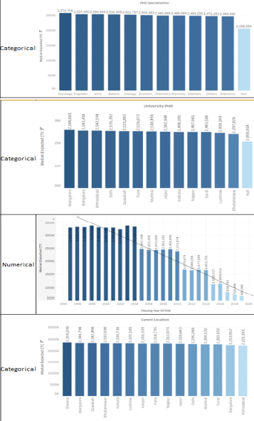
4% median expected CTC is increased as shown in graph for different fields
&% Median expected CTC increase is observed for different locations
79.8%Median expected CTC increase is observed
5% Median expected CTC increase is observed for current locations

Slide 15
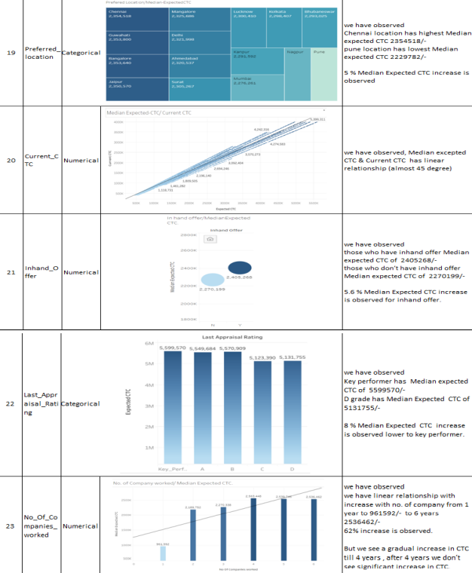

Slide 16
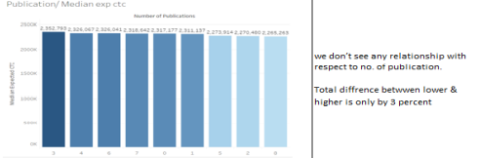
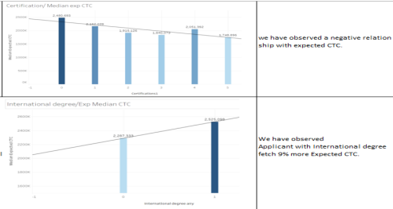

Slide 17
S.No | Models | Coefficient of Determination
1 | Boosted decision tree Regression. | 0.96
2 | Random Forest | 0.966
3 | Linear regression | 0.987

Slide 18
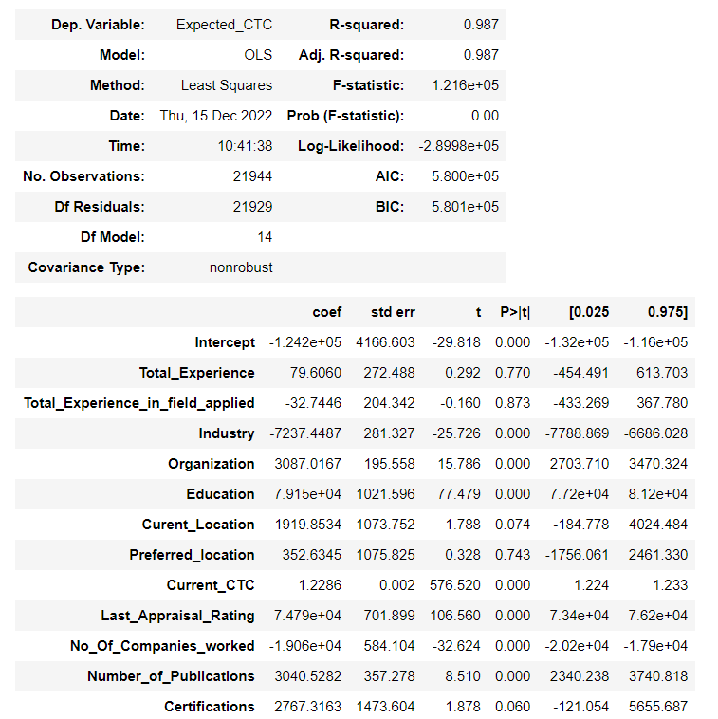
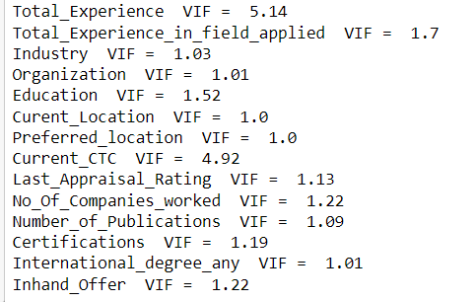
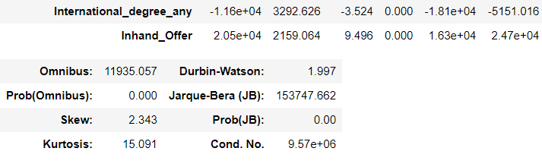
Base MLR Model

Slide 19
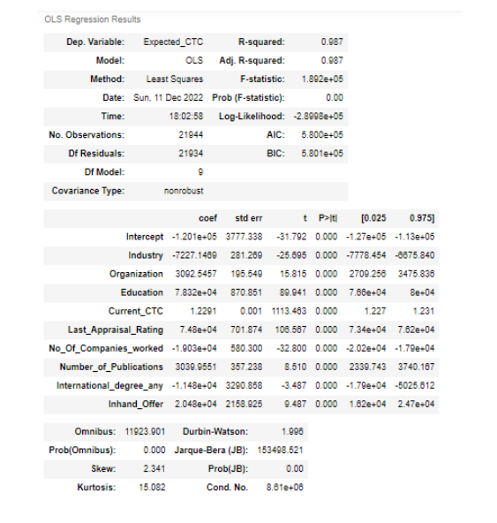
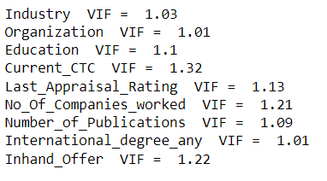
Best MLR Model
Interpretations :
We inferred that all the p_value are below the significance value and VIF values are also in the correct range.
Now, all statistical parameters being checked , so this model had all the appropriate things which must be required in our linear regression model.

Slide 20
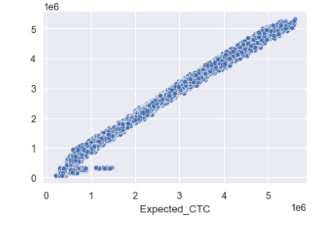
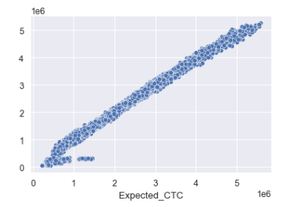
Scatter plot – Train Data Best Model MLR
Scatter plot – Test Data Best Model MLR
Interpretations : This shows a linear relationship as the predicted and actuals values were very close to each other. Hence the R2 is also high.
We inferred that both scatter plots for train and test are quite similar.
It means that the model we build using sklearn library was a very good model. It fits well

Slide 21

3 Important Business Recommendations
Current CTC
Location
Employees who worked earlier for big organizations

Slide 22


Slide 23


